Slide 2

5 Million by 2020:
PEPFAR TB Preventive Treatment (TPT) Priorities
Hank Tomlinson, Ph.D.
Director, Division of Global HIV & TB
Centers for Disease Control and Prevention
CQUIN Satellite – DSD and TB/HIV
Monday, July 22, 18:30 – 20:30

Slide 3

“If a new ART regimen were shown to reduce mortality by 37%, the demand for immediate access from clinicians, programmes, international agencies, and the advocacy community would be deafening.
The faint whispers for IPT must be amplified and action must be taken to reduce deaths from such an eminently preventable disease.”
Richard E. Chaisson, Jonathan E. Golub
Lancet Glob Health. 2017 Nov;5(11):e1048-e1049
3

Slide 4
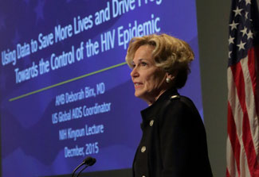
U.S. President’s Emergency Plan for AIDS Relief’s (PEPFAR) Commitment to TPT
14 million PLHIV
to complete at least
ONE course of TPT
$22.7 million
for TPT commodities
“If immediate ART is the cornerstone of PEPFAR’s TB/HIV efforts, then TB infection control and TB preventive therapy are the capstones…”
UNGA September 2018 -Ambassador Deborah Birx
4

Slide 5
PEPFAR has set ambitious targets for TPT acceleration
4x
Target: TPT Courses Completed (FY19) compared with Past Achievement
68%
Global TPT Courses Initiated in PEPFAR-supported Countries in 2017
*No data reported for Botswana, Cameroon,
Cote d’Ivoire, Malawi, Rwanda, South Sudan, and Ukraine
22 PEPFAR-Supported Countries

Slide 6
Bringing TPT to PLHIV in ART DSD Models
14 M
PLHIV on ART
Supported by PEPFAR
12.5 M
Viral Suppression
Eligible for ART DSD
◊ Multi-month ART
3 » 6 months
◊ Medical visits
every 6 months
◊ Fewer clinical touches by any health worker
◊ DSD enrollments rapidly increasing with improved viral load coverage
3.3 M
Start TPT Target
FY19
1.2 M
New on ART Target
FY19

Slide 7
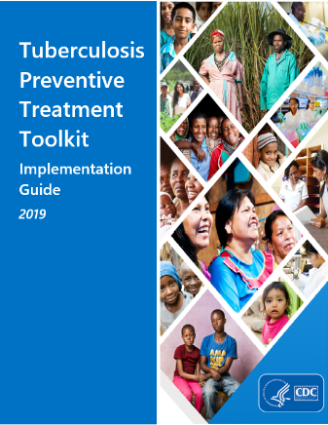
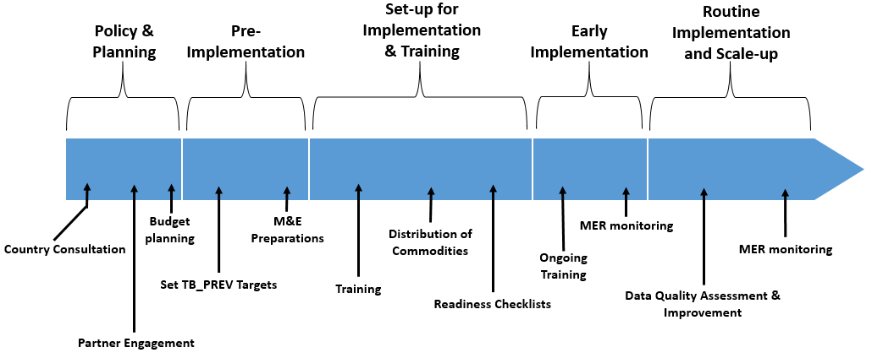
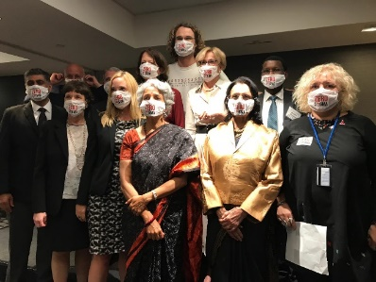
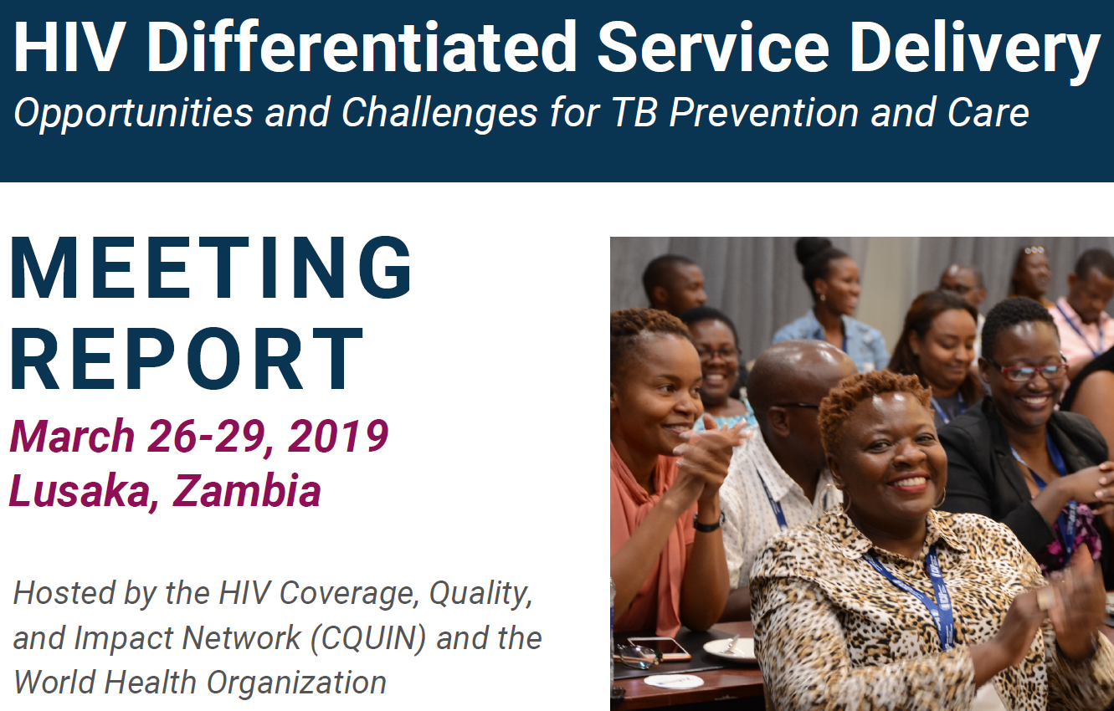
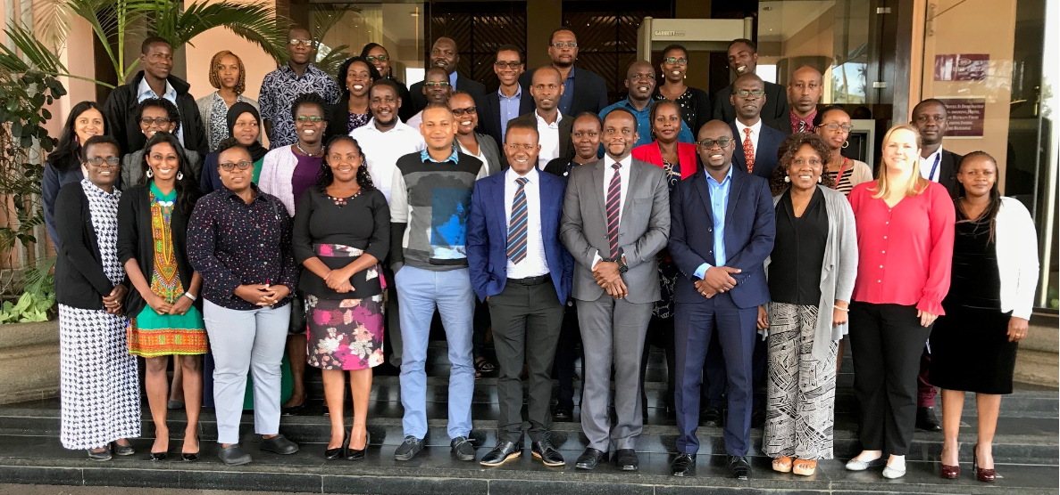
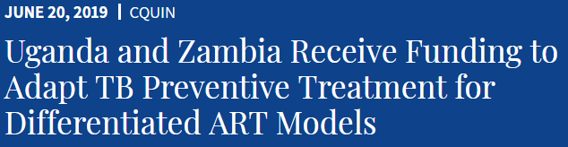
1
2
Strategy for
Scale up
Baseline Country Assessment
TPT Implementation Toolkit and Operational Guide
3
4
5
Advance
Technical Assistance
Partnerships
South-To-south tpt mentorship visit
Kenya — may 20-23, 2019
(Uganda, Zambia, Zimbabwe)
7

Slide 8
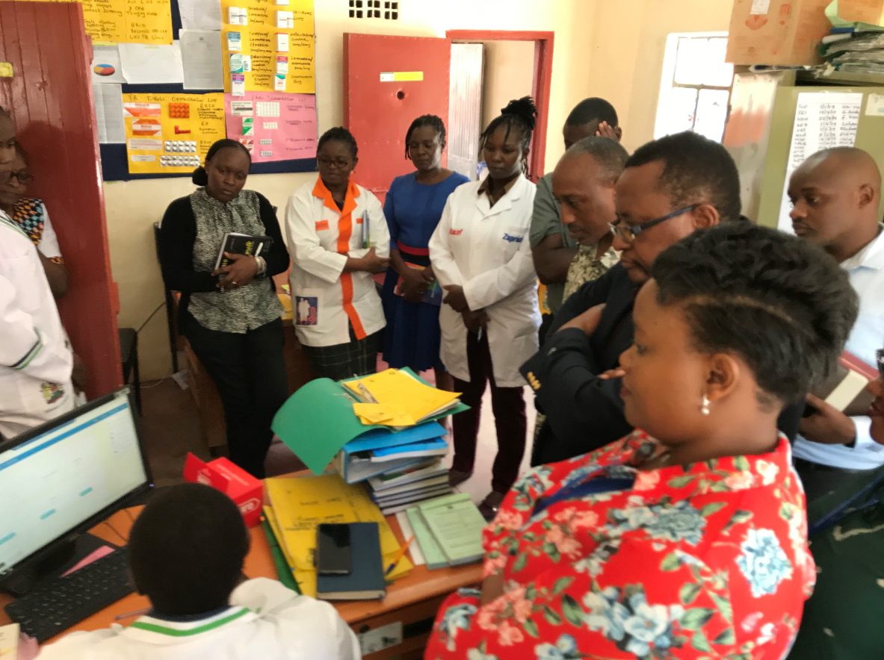
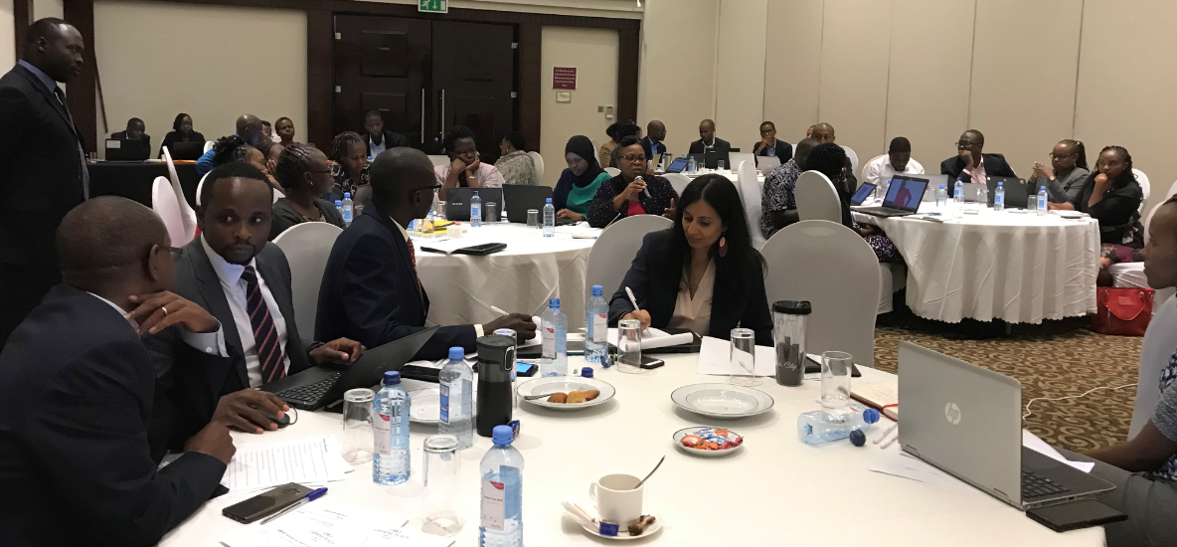
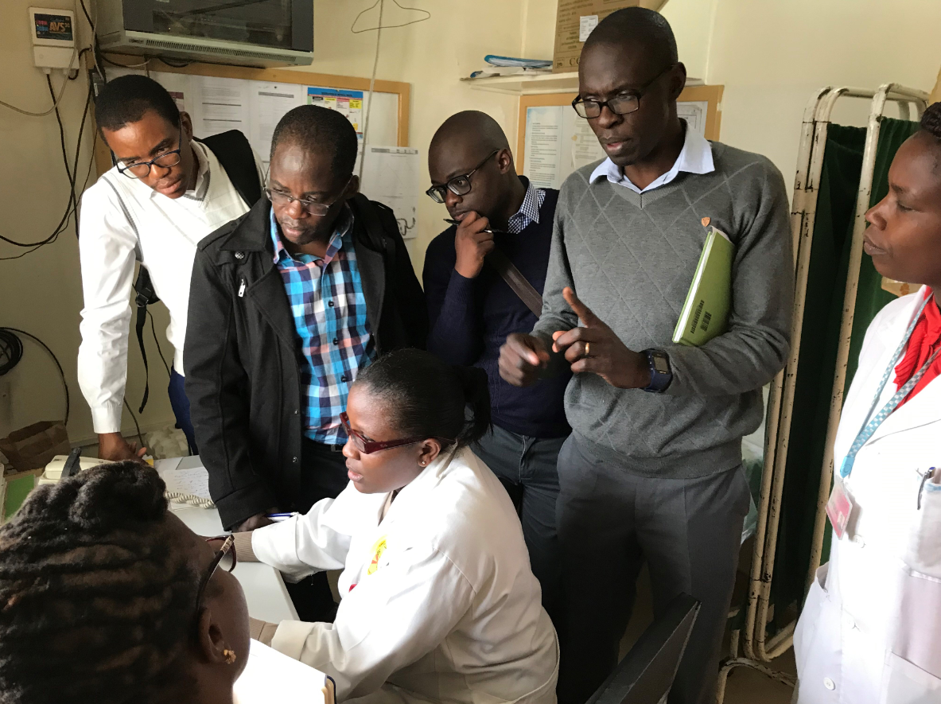
South to South Mentorship – Kenya, May 2019
Countries Participating: Uganda, Zimbabwe, Zambia
Learning from Kenya’s rapid acceleration to 85% TPT coverage
749,890
15,531

Slide 9


Zimbabwe and Uganda: HIV and TB Cascades
PLHIV
949,322
PLHIV
1,097,366
ART Patients Screened for TB
746,259 (79%)
ART Patients Screened for TB
1,019,445 (93%)
Screened Negative
730,691 (98%)
Screened Positive
15,568 (2%)
Screened Negative
948,338 (93%)
Screened Positive
71,107 (7%)
Specimen Sent
16,755 (108%)
Specimen Sent
65,643 (92%)
Expected to complete TPT
23,248 (3%)
Expected to complete TPT
19,103 (2%)
Positive Results Returned
2,503 (15%)
Positive Results Returned
5,409 (8%)
Completed TPT
17,826 (77%)
Started on TB Treatment
5,287 (211%)
Completed TPT
13,419 (70%)
Started on TB therapy
8,219 (152%)
Source: PEPFAR Panorama; Accessed 02 July 2019; Denominator for percentage is category above

Slide 10
95%
67%
93%
38%
4%
77%
5%
70%

Slide 11
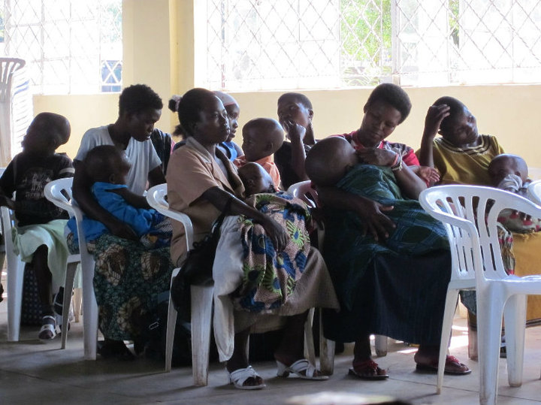
Opportunities and Way Forward
Opportunities
6 month multi-scripting
3HP and short-course regimens
M&E system
Supply chain
Community involvement
Way Forward
TPT Tool Kit
Collaborate with GF and partners to reduce 3HP cost
DSD as an opportunity for TPT

Slide 12
Acknowledgements
Cuc Hong Tran
Bill Coggin
Sarita Shah
Adam Macneil
Anand Date
Minesh Shah
Brittany Moore
Susan Maloney
Tony Ao
For more information, please contact:
Hank Tomlinson, Ph.D.
hjg7@cdc.gov
Office of the Director, Division of Global HIV & TB

